Slide 1

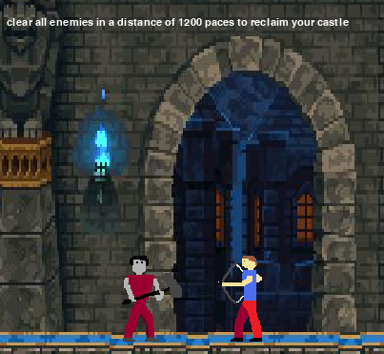
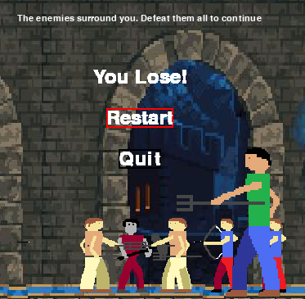
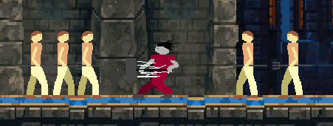
CPSC 4160 Twilight Hammer
Zachary Schmitz
Game Description
Game Mechanics
Controls
Twilight Hammer is a 2-D sidescrolling beat-em-up, where the main character is a vampire lord awaken from a long slumber, only to find that his castle has been overrun by the living. This is absolutely intolerable.
The gameplay mechanics are simple. Move left and right with the arrow keys. Swing your mighty hammer with the z button, and leap into the sky with the c button. You must also balance the range of the archers, who will try to stay within a certain distance away from you, in order to defeat them during the blockers. The melee enemies will close in to attack you at close range while the archers will maneuver to stay within a certain distance of you, while also out of your hammer’s swing range.
During the blocker phases, the character’s movement range will be limited to a smaller region, wherein local bosses and hordes of units will attack the player. Defeating the archers in each blocker will require a degree of tactics to draw them within range of your melee attacks while they try to maintain their balance.
The controls for the character are simple. Swing your mighty hammer with the z button, and leap into the sky with the c button. Additionally, you can maneuver the menus with the up and down arrows and either press the z or enter key to select an option.
Game objective
The objective of the game is simple. You need to move to the right, battling through hordes of the living to purify your castle. This is achieved by fighting to a distance of over 7000 paces and defeating every enemy in the way. To do so you must pass through multiple blockers, wherein your enemies will pour forth from both sides of the screen and your movement will be limited.
Game Limitations
One of the most severe limitations of this title is my own artistic ability. I am not a digital artist, and therefore I am limited to what I can achieve through pixel art, while still trying to adhere to the atmosphere and color pallets of the world. Other than that, only the computational complexity and engine limitations of pygame limit the capabilities of the project, and with sufficient time it could expand into much more.
Game Screenshots
Technical Description
Technically speaking, twilight hammer is made with simple sprites and mechanics in order to allow a large number of simultaneous enemies on screen. This being done in pygame engine, means that the player might have to contend with several dozen enemies at the same time, but it will still move smoothly.
Future Work
In the future, Twilight Hammer has the possibility to expand significantly, as the foundation for expansion is already in place. The fundamental mechanics and object handling mechanisms are in place, so additional content would be as simple as merely plugging in new sprites and images to expand.
Notes:
Download more poster presentation templates from FPPT.com

